Slide 1
Project Conception & Details
CODE’IN Social media App

Slide 2
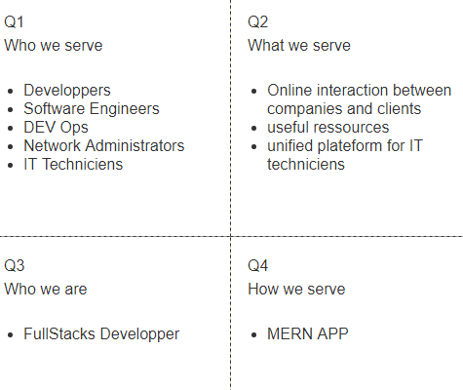
Description of Needs and Relations between The users

Slide 3
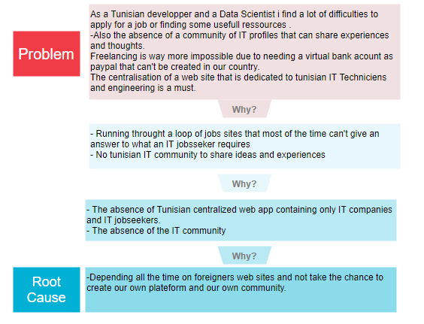

Slide 4
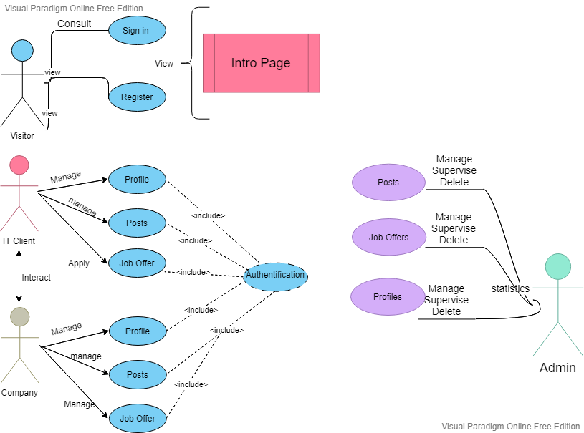
UML :Use Case Diagram

Slide 5
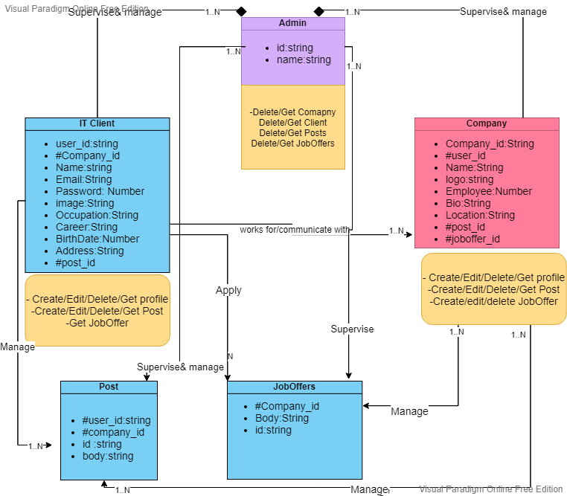

Slide 6
User Story
As a visitor , i can read a briefing resume about the site content
As a visitor i can make an account and sign in
As a user , i have the ability and the choice to wether represent myself as an IT Client or represent a company in wich i work
As an IT Client , i can fill my profile page with the necessary information and be able to add any experience or certificate , or update any required fields
As an IT Client i have the ability to post any idea or any content that respects the site agreements
As an IT Client i can apply to any job As a company , i can create , update and delete my profile
As a company , i can share posts , and job offers
As a company , i can hire any IT Client

Slide 7
As an admin i can supervise and moniter the web app As an admin , i can delete users profiles , check posts and job offers ,
As an admin i can have the number of accounts created, number of posts and job offers in the web app

